Slide 1

Home Loan Default Risk Prediction
MEMBERS
Subham Basu Roy Chowdhury – MT2022118
Swaroop Dixit – MT2022121

Slide 2
Problem Statement
Many people struggle to get loans due to insufficient or non-existent credit histories. And, unfortunately, this population is often taken advantage of by untrustworthy lenders.
Home Credit strives to broaden financial inclusion for the unbanked population by providing a positive and safe borrowing experience. In order to make sure this underserved population has a positive loan experience, Home Credit makes use of a variety of alternative data--including telco and transactional information--to predict their clients' repayment abilities.

Slide 3
Steps Performed:
1. IMPORTING ESSENTIALS LIBRARIES
2. IMPORTING DATA AND VISUALIZATION
4. FEATURE SELECTION
5. FEATURE ENGINEERING
3. PRE-PROCESSING THE DATA
6. APPLYING VARIOUS CLASSFIER AGLORITHMS

Slide 4
1. IMPORTING ESSENTIALS LIBRARIES
Here we have imported the necessary libraries like
Numpy: Mathematical operations
Pandas: Working and manipulating the given dataset.
Seaborn and Matplotlib : To plot graphs.
Sklearn : To perform EDA and Building sample predictions

Slide 5
2. IMPORTING DATA AND DATA VISUALIZATION
Loading the given dataset mainly the training data as of now.
Printing the basic information and the getting a brief overview of the entire data.
Plotting various graphs over the given features and the TARGET column
We are plotting histograms with the TARGET column and the column that have more than 100 unique features and countplot with the features that have less than 100 unique features.

Slide 6
3. PRE-PROCESSING THE DATA
Drop the ID Column and the output TARGET column and create X and Y data sets.
Finding the columns that have NULL values more than 65%, drop them
Check for duplicate rows in the dataset if present then drop them by keeping the first occurrence.
Check if NULL is still present, if so replace the NULL values in the numeric features by their median and for the Categorical Data with their mode(most frequently occuring).

Slide 7
4. FEATURE ENGINEERING
Label Encoding the Entire Dataset and in terms converting all the features into Int/float type.
Finding correlation of independent features with output
Dropping those columns whose corelation with the output is less than or equal to 0.005
Dimensionality reduction using lasso regression and rejecting the columns as per the output
Identifying the outliers using boxplot and removing them using inter quartile range method by replacing them with the mean of respective features
Scaling the entire dataset using standard scalar library from sklearn

Slide 8
5. APPLYING VARIOUS CLASSIFIERS.
We have used Logistic Regression on the training dataset and have used F1 score and ROC AUC score as a performance metrics. Wehave used Logistic Regression on the training dataset and the F1 score and the ROC AUC score.W have used Logistic Regression on the training dataset and the F1 score and ROC AUC score as
Accuracy obtained is 91.92 %
F1 score = 91.92 %
ROC AUC score = 50 %

Slide 9
6. Future Scope
Do
Do pre-processing on the Test Data
Handle
Handle the issue of the imbalanced dataset using SMOTE
Implement
Implement PCA for better feature selection
Improve
Improve the accuracy of the MODEL by applying more advanced models like Naïve-Bayes Classifier or XgBoost, etc

Slide 10

CHECKPOINT 2

Slide 11
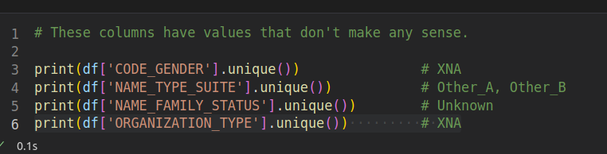
Pre-processing
We found some absurd values in the categorical columns:
We replaced these values by nan and then further replaced these nan.

Slide 12

Removing Imbalance
Initially we found that the dataset was highly imbalanced.
Hence, we used oversampling technique to remove this issue.
We used various models like SMOTE, KMeansSMOTE, SVMSmote and ADASYN.
All of them seemed to work nicely but we decided to go with ADASYN because the ratio of the 0 and 1 generated by it was better compared to the other models plus the data after oversampling was also less compared to other models.

Slide 13

Feature Selection
Initially we had used Lasso Regression to pick the features that are best candidates to predict if a loan is going to default or not.
Now we have replaced it by Random Forest Classifier followed by Select From Model feature selection class from Sklearn library.

Slide 14

END of PRE-PROCESSING AND EDA
After creating the synthetic data using ADASYN we scaled our training data using the StandardScalar library of Sklearn.
We also imported our test data and reproduced all the pre-processing and the EDA steps as our Training data.
This completes our entire pre-processing and the EDA.

Slide 15

Predicting Models
Logistic Regression
K Nearest Neighbours
XG Boost
Decision Trees
Random Forest
Gaussian Naïve Bayes
Bernoulli Naïve Bayes

Slide 16
Hyperparameter Tuning
Our best models was XG Boost hence we decided to do hyperparameter tuning for XG Boost to further increase the accuracy produce by it.
So we used GridSearchCV to do hyperparameter tuning to find out the best possible parameters for our model.

Slide 17
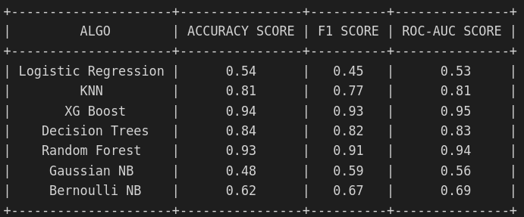
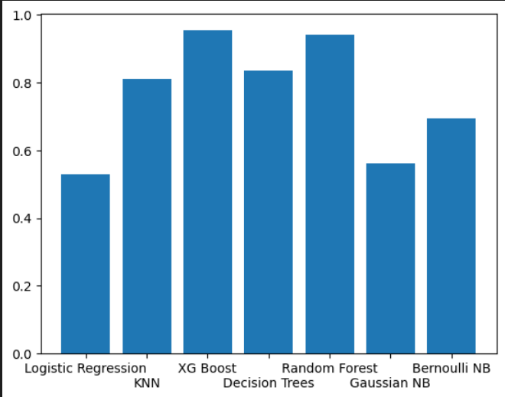
Comparison
XG Boost and Random Forest gave the best F1_Score and Roc_Auc Score hence we created our Y_pred value of the test dataset with these models. And made a subsequent submission on Kaggle receiving a score of 0.523
fdjighfdg

Slide 18

Version Control
We have pushed our code into Github Repository
GIT URL: https://github.com/sbrc1996/IIITB-ML/tree/master

Slide 19
Future Scope
Try to do more hyperparameter tuning on the remaining models and check if the accruacy is increasing or not.
Try get a good accuracy in the Kaggle Leaderboard.
Deploy the model by creating an interactive User Interface and Accurate Prediction

